Slide 1

CSE 163
Syllabus
Introduction to Python
Hunter Schafer

Slide 2
Agenda
Overview
What is this class? Who is taking this class?
Who are we?
Syllabus
Development Environment
Python Crash Course - Day 1
Hello world
REPL vs. Script
Variables and Arithmetic

Slide 3
Overview
What is this class?
Competencies
More advanced programming concepts than in CSE 142 or CSE 160 including how to write bigger programs with multiple classes and modules.
How to work with different types of data: tabular, text, images, geo-spatial, etc.
Ecosystem of data science tools including Jupyter Notebook and various data science libraries including scikit-image, scikit-learn, and pandas data frames.
Basic concepts related to code complexity, efficiency of different types of data structures, and memory management.

Slide 4
Overview
Who is taking this class?
This class is designed to have students from
142: Know control structures, file I/O, arrays in Java
Will spend first weeks learning 142 in Python fast!
Practice is KEY!
160: Know control structures, file I/O, data structures in Python
First week will be review while everyone learns Python
143 or Beyond: Seen more advanced programming in Java
Class material should be complementary to what you would have learned in 143
Competency 1 is aimed at the 143 level of programming

Slide 5
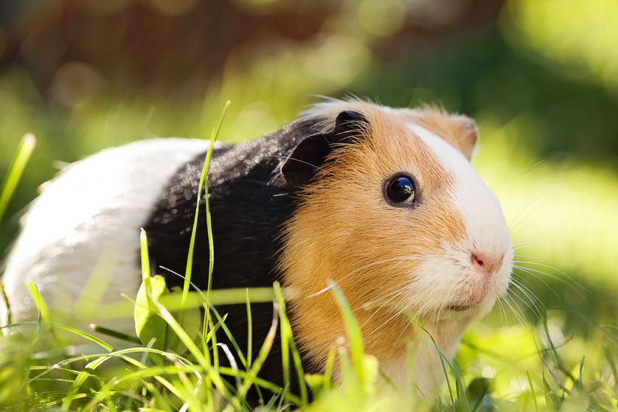

Slide 6

Who am I?
Hunter Schafer, Lecturer
Office Hours
Time: 10:30 am - 12:30 pm, Wednesdays
Location: CSE 444
Contact
Personal Matters: hschafer@cs.washington.edu
Course Content + Logistics: Piazza

Slide 7






Who are the TAs?
AA (12:30)
AB (1:30)
AC (2:30)
Erika Wolfe
eywolfe@cs
Dylan Jergens
dylanj7@cs
Nicole Riley
nriley16@cs
Josh Ervin
joshue@cs
Erik Hoberg
ehoberg@cs
Joely Nelson
joelyn@cs

Slide 8
Syllabus

Slide 9

Mon
Tue
Wed
Thur
Fri
Lecture
Nothing 😢
Lecture
Section
Lecture
Prev HW Due
Next HW Released
Project Checkpoints
We don’t record attendance in lecture/section, but attending these sessions is expected
Panopto for Lecture (on Canvas)

Slide 10
Homeworks + Project
With the scaffolding from 1 and 2, you are probably now capable to tackle the homeworks. These will be complex and challenging, but you’ll continue to learn by doing.
1
Sections
Practice material covered in 1 in a context where a TA can help you. The emphasis is still on you learning by doing.
2
Lectures
Introduced to material for the first time. Mixed with activities and demos to give you a chance to learn by doing. No where near mastery yet!
3

Slide 11
Assessment
Your learning from this course will be assessed by:
Weekly Homework Assignments
Weight: 60%
Number: Approximately 7
Exams
Weight: 25%
Number: 2 Exams
Final Project
Weight: 15%
Number: Just one project, but multiple check-ins

Slide 12
Homework Logistics
Late Days
5 Free Late Days for the whole quarter.
Can use up to 2 Late Days on any assignment.
Each Late Day used after the 5 Free Late Days results in a -5% on that assignment
Collaboration
You are encouraged to discuss assignments and concepts at a high level
If you have code in front of you in your discussion, probably NOT high level
All code and answers submitted must be your own
Project can be done in groups of 2
Getting Help
Piazza (link with add code in Syllabus)
Office Hours

Slide 13
Project
Culmination of all the things you learned in this class.
Open ended project where you find and use real-world datasets to answer an interesting question.
Broken into various checkpoints throughout quarter:
Find some possible ideas for datasets and questions
Pick a research question and your datasets + find a partner
Outline methodology and define work plan
Gather results and write final report
Final Project presentations during final exam slot

Slide 14
Python Crash Course
Day 1

Slide 15
Hello World!
Write a file called hello.py that prints “Hello World!”
Attempt 1
print('Hello World!')
Attempt 2
def main():
print('Hello World!')
if __name__ == '__main__':
main()

Slide 16
Python Modes
Script
Write a .py file and run it python my_file.py
Runs file from top to bottom
Your HW + Project
Interactive Shell
Read Evaluate Print Loop (REPL)
Interactive mode to try small chunks of code
Simple: python
Complex: Jupyter Notebook
Lecture (usually)
Follow Software instructions to set up your computer for development

Slide 17
Variables
A variable is a named box that stores a value
Variables are defined as: <name> = <value>
Examples
3
x = 3
y = 4.2
x = 3.7
x
3.7
y
4.2
A variable can only hold a single value* at any point in time, but the same variable can hold different types of data throughout the whole program
We call Python a dynamically typed programming language because the type of a variable can change
* We will see how to store more than one thing at a time later

Slide 18
Expressions
Right hand side doesn’t have to be a simple value (e.g. 4.2), but can be an expression that evaluates to a simple value
You probably know most operators for expressions from your programming background.
a = 2 + 3 # addition
b = a - 1 # subtraction
c = (b + a) * 2 # nested, multiplication
d = 3 / 2 # division
e = 3 // 2 # integer division
f = a % b # mod
g = b ** 2 # exponentiation
a
5
b
4
c
18
d
1.5
e
1
f
1
g
16

Slide 19
Goal: Get you actively participating in your learning
Typical Activity
Question is posed
Think (1 min): Think about the question on your own
Pair (2 min): Talk with your neighbor to discuss question
If you arrive at different conclusions, discuss your logic and figure out why you differ!
If you arrived at the same conclusion, discuss why the other answers might be wrong!
Share (1 min): We discuss the conclusions as a class
During each of the Think and Pair stages, you will respond to the question via a Poll Everywhere poll
The poll will only be open for the last 15 seconds of each of the stage
Not worth any points, just here to help you learn!

Slide 20
1 minute
Make a prediction of what this program will output.
Note that print(1, 2, 3) outputs: 1 2 3
x = 5
y = 7
z = y - x
x = 2
y = z / 2
print(x, y, z)
Options
2 2.5 5
2 1.0 2
2 2 2
2 1 2

Slide 21
1 minute
Make a prediction of what this program will output.
Note that print(1, 2, 3) outputs: 1 2 3
x = 5
y = 7
z = y - x
x = 2
y = z / 2
print(x, y, z)
Options
2 2.5 5
2 1.0 2
2 2 2
2 1 2

Slide 22
Next Time
Jupyter Notebooks
Python Crash Course - Day 2
Conditionals
Functions, parameters, returns
Strings
Documenting code
Testing code
Before Next Time
Fill out begin of quarter survey
Worth 2 points
Due @ 1 pm, no late days
Setup software for course
Try practice problems from today

Slide 23
bool
True/False
A bool has two values: True, False
Can you logical operators: and, or, not
b1 = False
b2 = True
print(b1 and b2)
print(b1 or b2)
print(not b2 or b1)
print(not (b2 or b1))
b1 = False
b2 = True
print(b1 and b2) # False
print(b1 or b2) # True
print(not b2 or b1) # False
print(not (b2 or b1)) # False
Can get bools by comparing numbers
x = 3
print(x < 4)
print(x >= 5)
print(x == 2)
x = 3
print(x < 4) # True
print(x >= 5) # False
print(x == 2) # False
Notes:
Didn’t get to today, will cover Wednesday

Slide 24
Casting + Types
Every piece of data in Python has a type. You can convert between types by casting.
x = 1.4
print(x)
print(int(x))
x = 1.4
print(x) # 1.4
print(int(x)) # 1
x = 1.4
print(x) # 1.4
print(int(x)) # 1
x = "1.7"
print(float(x))
print(int(x))
x = 1.4
print(x) # 1.4
print(int(x)) # 1
x = "1.7"
print(float(x)) # 1.7
print(int(x)) # Error
Commonly used types: int, float, bool, str, char
Can use type(x) to find x’s type
Notes:
Didn’t get to today, will cover Wednesday

Slide 25
While Loop
A while loop has a condition and a body. It executes the body repeatedly until the condition is false.
x = 1
while x < 100:
print(x)
x = x * 2
print('After loop', x)
1
2
4
8
16
32
64
After loop 128
Important: Python uses indentation to determine what belongs inside the loop!
Very common beginner error IndentationError: unexpected indent
Notes:
Didn’t get to today, will cover Wednesday

Slide 26
For loop
If you know Java, for loops in Python look pretty different
We won’t give a formal definition of a for loop at this time, but will start with a simple example
for i in range(5):
print(i)
print('After loop', i)
0
1
2
3
4
After loop 4
The many uses of range
range(A)
Numbers between 0 inc. and A exc.
range(A, B)
Numbers between A inc. and B exc.
range(A, B, C)
Numbers between A inc. and B exc. (steps by C)
Notes:
Didn’t get to today, will cover Wednesday

Slide 27
2 minutes
Make a prediction of what this program will output.
Note: j -= 1 is the same thing as j = j - 1
for i in range(2, 11, 3):
j = i - 1
while i >= 1 and i % j != 0:
j -= 1
print(i, ':', j)
Options (new line separated by /)
2 : 2 / 5 : 5 / 8 : 8
2 : 2 / 5 : 5 / 8 : 8 / 11 : 11
2 : 1 / 5 : 1 / 8 : 4
2 : 1 / 5 : 1 / 8 : 4 / 11 : 1
2 : 1 / 5 : 4 / 8 : 7 / 11 : 10
Notes:
Didn’t get to today, will cover Wednesday

